Slide 1
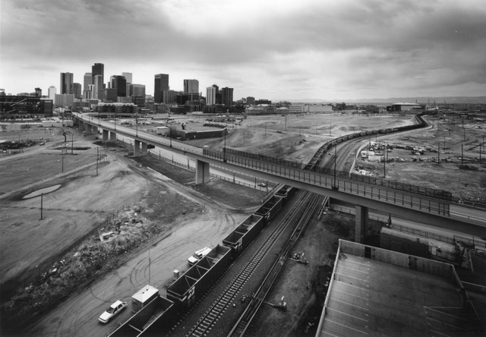
The Last Mile
Conducted by Shane McGuckian, Chris Johnson, Paul Cyr, Charley Dixon, and Molly Emmett
with the support of the smart data analytics project

Slide 2
Contents
The Problem
The Focus
The Context
The Process
The Potential

Slide 3
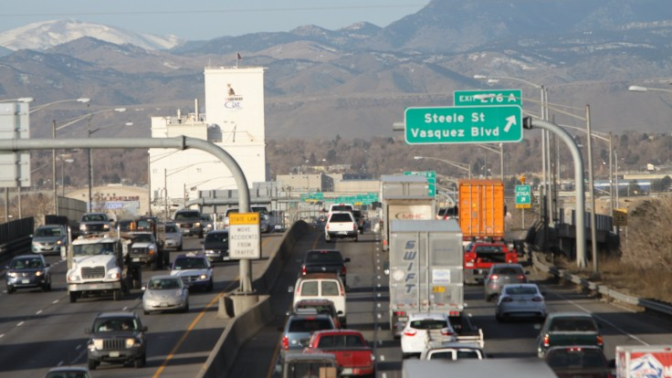
Denver has a traffic problem.
How can we use data to mitigate it?

Slide 4
The focus
To what extent are ‘last mile’ vehicles actually utilized for last mile transportation?

Slide 5
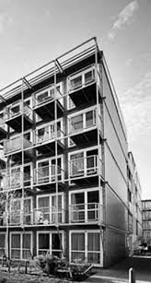

The Context
Last mile transportation is defined as the movement of goods or people from a transportation hub to the final delivery destination.

Slide 6
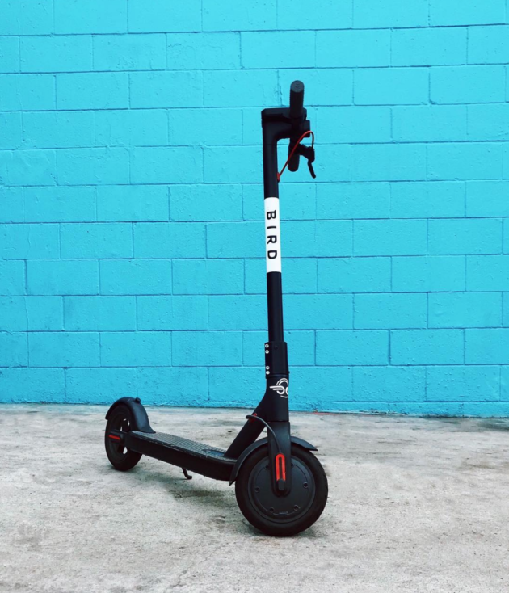
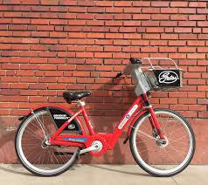
The Context
Denver’s Dockless Mobility Pilot Permit Program is a one year trial for the use and analysis of scooter and bike sharing programs.
The program is an attempt to measure whether these vehicles can contribute to the mobility goal of reducing single-occupant vehicle commute trips from 73% to 50% by 2030.

Slide 7
The process
Examination of the existing data on bike and scooter shares in Denver.
We found that although robust transportation data exists, we needed to look further for geospatial and temporal bike and scooter sharing data.

Slide 8
The process
2. Retrieval of geospatial and temporal data from the Bird and B-Cycle APIs.
We wrote Python code to pull the following data from the Bird and B-Cycle APIs.
Bird | B-Cycle
Vehicle ID # Position Captive Battery Level | Station ID # Docks Available # Installed # Renting # Returning Last Reported Types of Bikes Available

Slide 9
The process
3. Conversion of geospatial and temporal data.
In order to overlay the data with mapped transit hubs and sequence it temporally, we uniformly converted the existing formats.

Slide 10
The potential
At this point in the year, Denver has only housed both bike and scooter shares for two seasons: summer and fall of 2018.
Our time ran short, and the existing data in December 2018 is not a reflection of multimodal transportation’s impact on a calendar year of Denver transit.
We propose continuing this project at the end of spring 2019. We could predict scooter and bike share use through geospatial relation to stations proximal geographically and/or demographically.

Slide 11
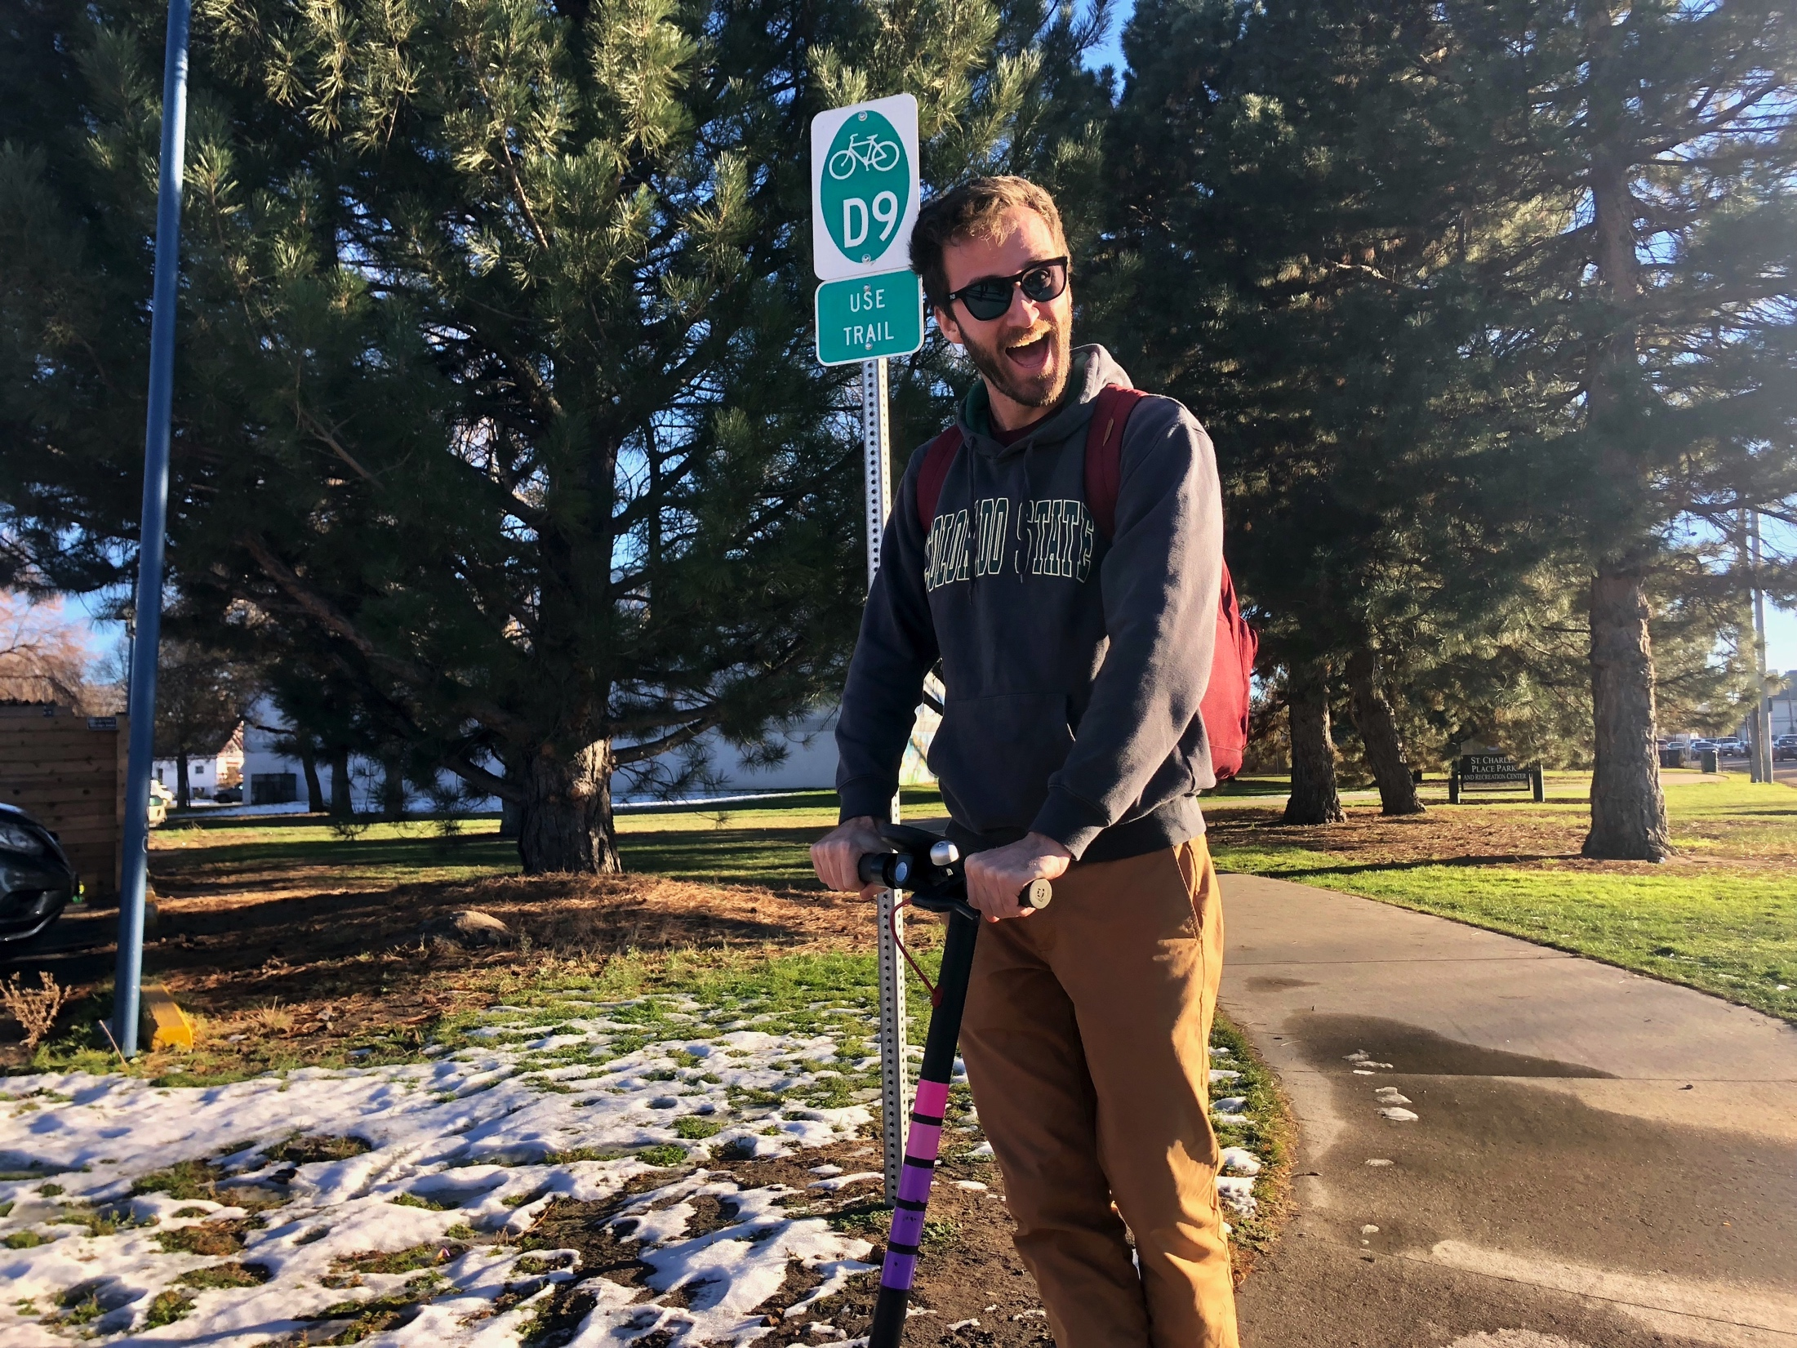
The Paul
Primary research was conducted in pursuit of this project.

